Slide 1
Deep Models for Face Alignment and Pose Normalization
Shiguang Shan
Institute of Computing Technology, Chinese Academy of Sciences
VALSE QQ Webinar, 2014.11.25

Slide 2
Outline
Background
CNN (+big data) for feature learning
Deep learning for nonlinear regression
DAE for face alignment
DAE for pose normalization
Summary and discussion

Slide 3
Historical Perspective
History of face recognition is that of benchmarking databases and protocols!!
Milestones
ORL, Extended Yale B: 1990~2012 (<50 persons)
Identification rate: 95%~99%
FERET: 1994~2010 (1196 persons, 2~5 ipp)
Identification rate: 94% (for Dup.I and Dup.II)
FRGC v2.0: 2004~2012 (~500 subjects, >50ipp)
Verification Rate (VR) = 96.1% @ FAR=0.1%
LFW: 2007~currently (~5749 subjects, 1680>2 ipp)
VR=94.5% @FAR=1% [Unrestricted, Labeled Outside Data]
VR=87.0% @FAR=0.1% [Unrestricted, Labeled Outside Data]

Slide 4
Historical Perspective
History of face recognition is that of benchmarking databases and protocols!!
Milestones
ORL, Extended Yale B: 1990~2012 (<50 persons)
SRC and variants [J.Wright et al, 2008]
FERET: 1994~2010 (1196 persons, 2~5 ipp)
LGBP + B-LDA [S.Xie, S.Shan, X.Chen, IEEE T IP10]
FRGC v2.0: 2004~2012 (~500 subjects, >50ipp)
LPQ + LGBP + B-LDA [Y.Li, S.Shan, H.Zhang, S.Lao, X.Chen, ACCV12]
LFW: 2007~currently (~5749 subjects, 1680>2 ipp)
DeepID [Y. Sun, X. Wang, and X. Tang, CVPR14]
DeepFace [Y.Taigman, M. Yang, M.Ranzato, L. Wolf, CVPR14]
What’s next?

Slide 5
Historical Perspective
(semi-)Solved (near frontal faces)
Access control, duplicate ID checking…
Controlled environment, cooperative users--FERET
Not fully solved: aging, plastic surgery
Partially solved (<30º rotation)
Face retrieval based on Internet photos
Esp. recognition of celebrities--LFW-like scenario
Not solved: large pose, make-up, plastic surgery…
Far from solved (full pose)
Video surveillance: still to video; video to image; video to video
Challenges: low quality/resolution, pose, lighting, aging
Big issue: lack of real-world datasets & benchmarks

Slide 6
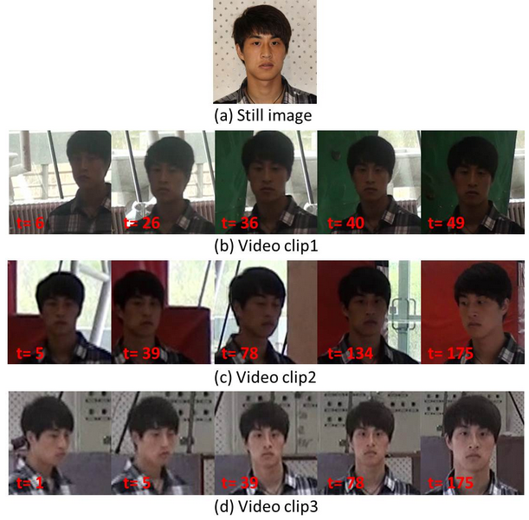
Advertisement: a new database
COX video face database
http://vipl.ict.ac.cn/resources/datasets/cox-face-dataset
Features of COX
1000 subjects, each
1 high quality still image
3 low quality video clips from 3 camcorders
(Intended to) simulate video surveillance
Evaluation protocols

Slide 7
Outline
Background
CNN (+big data) for feature learning
Deep learning for nonlinear regression
DAE for face alignment
DAE for pose normalization
Summary and discussion

Slide 8
Outline
Background
CNN (+big data) for feature learning
For EmotioW 2014 challenge
For FG2015 video FR challenge
Deep learning for nonlinear regression
DAE for face alignment
DAE for pose normalization
Summary and discussion
M. Liu, R. Wang, S. Li, Z.Huang, S.Shan, X. Chen. Combining Multiple Kernel Methods on Riemannian Manifold for Emotion Recognition in the Wild. ACM ICMI 2014

Slide 9
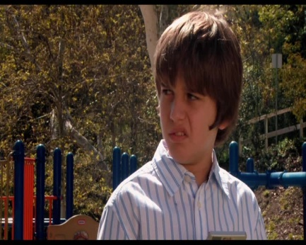
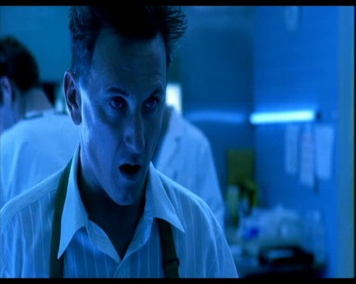

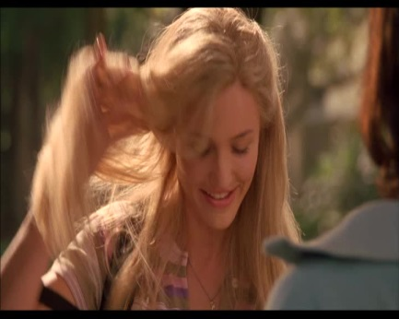
EmotioW 2014: Task
Task
Classify a sample audio-video clip into one of the seven categories
Neutral, anger, disgust, fear, happy, sad, surprise
Challenge
Close-to-real-world conditions
Large variations e.g. head pose, illumination, partial occlusion, etc.

Slide 10
EmotioW 2014: Data
Challenging data
AFEW* 4.0 database
audio-video clips collected from movies showing close-to-real-world conditions
Attribute of AFEW 4.0 | Description
Length of sequences | 300-5400ms
Number of annotators | 3
Emotion categories | Anger, disgust, fear, happiness, neutral, sadness, and surprise
Audio/Video format | Audio: WAV; Video: AVI
# of samples | 1368
# of subjects | 428
# of movies | 111
*Acted Facial Expression in Wild

Slide 11
EmotioW 2014: Protocols
Evaluation protocols
Dataset division: training, validation, and testing
The test labels were unknown.
Either audio/video modality or both can be used.
Set | # of subjects | Min. Age | Max. Age | Avg. Age | # of Males | # of Females
Train | 177 | 5 | 76 | 34 | 102 | 75
Val | 136 | 10 | 70 | 35 | 78 | 58
Test | 115 | 5 | 88 | 34 | 64 | 51
 | Anger | Digust | Fear | Happiness | Neutral | Sadness | Surprise
Train | 92 | 66 | 66 | 105 | 102 | 82 | 54
Val | 59 | 39 | 44 | 63 | 61 | 59 | 46
Test | 58 | 26 | 46 | 81 | 117 | 53 | 26

Slide 12
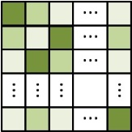
Our method
Stage 1: Emotion Video Representation
Image Feature on Aligned Faces
Video (Image Set) Modeling
…
…
HOG
Dense SIFT
DCNN
Linear Subspace
Covariance Matrix
Gaussian Distribution
Stage 2: Emotion Video Recognition
Classification on Riemannian Manifold via Kernel SVM/LR/PLS
Score-level Fusion
M. Liu, R. Wang, S. Li, Z.Huang, S.Shan, X. Chen. Combining Multiple Kernel Methods on Riemannian Manifold for Emotion Recognition in the Wild. ACM ICMI 2014

Slide 13
Our method
Image features
Aligned face images: 64x64; Features: HOG, dense SIFT, DCNN.
DCNN
CaffeNet trained on CFW database
Trained over 150,000 face images from 1520 subjects
Identities are served as supervised label in the deep networks
Architecture 3@237x237 > 96@57x57 > 96@28x28 > 256@28x28 > 384@14x14 > 256@14x14 > 256@7x7 > 4096 > 1520
Output of the last convolutional layer as final image features: 256x7x7=12, 544
HOG
Block size: 16x16; stride: 8; # of blocks: 7x7=49
# of cells per block: 2x2; # of bins: 9; # of total dims: 2x2x9x49=1764
Dense SIFT
Block size: 16x16; stride: 8; # of points: 7x7=49
# of dims per point: 4x4x8=128; # of total dims: 128x49=6272

Slide 14
Our Results
Combine multiple features
Methods |  | Accuracy (%)
 |  | Validation set | Test set
Baseline (provided by EmotiW organizers) |  | 34.40 | 33.70
Audio (OpenSMILE Toolkit) |  | 30.73 | --
Video | HOG | 38.01 | --
 | Dense SIFT | 43.94 | --
 | DCNN (Caffe-CFW) | 43.40 | --
 | HOG + Dense SIFT | 44.47 | --
 | HOG + Dense SIFT + DCNN (Caffe-CFW) | 45.28 | --
Audio + Video ( HOG+Dense SIFT ) |  | 46.36 | 46.68
Audio+Video ( HOG + Dense SIFT + DCNN (Caffe-CFW) ) |  | 48.52 | 50.37

Slide 15
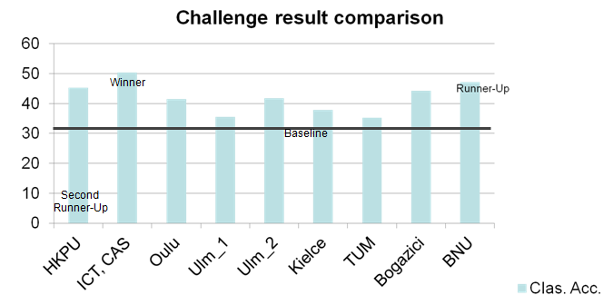
Final Results of Competition

Slide 16
Outline
Background
CNN (+big data) for feature learning
For EmotioW 2014 challenge
For FG2015 video FR challenge
Deep learning for nonlinear regression
DAE for face alignment
DAE for pose normalization
Summary and discussion

Slide 17
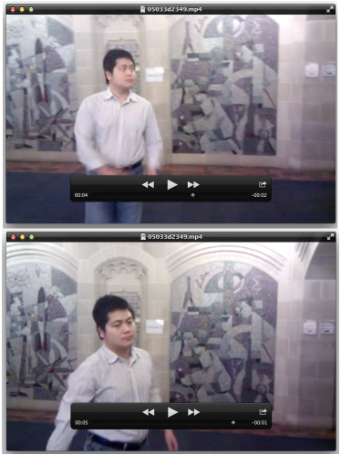
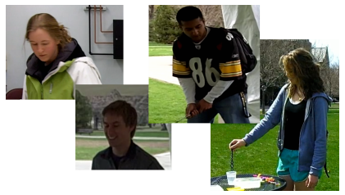
FG 2015 Video FR Challenge
Task: video-to-video face verification
Exp. 1: Controlled case
Video-to-video verification
1920*1080 video captured by mounted camera
Exp. 2: Handheld case
Video-to-video verification
Varying resolution from 640*480~1280*720
Videos from a mix of different handheld point-and-shoot video cameras

Slide 18
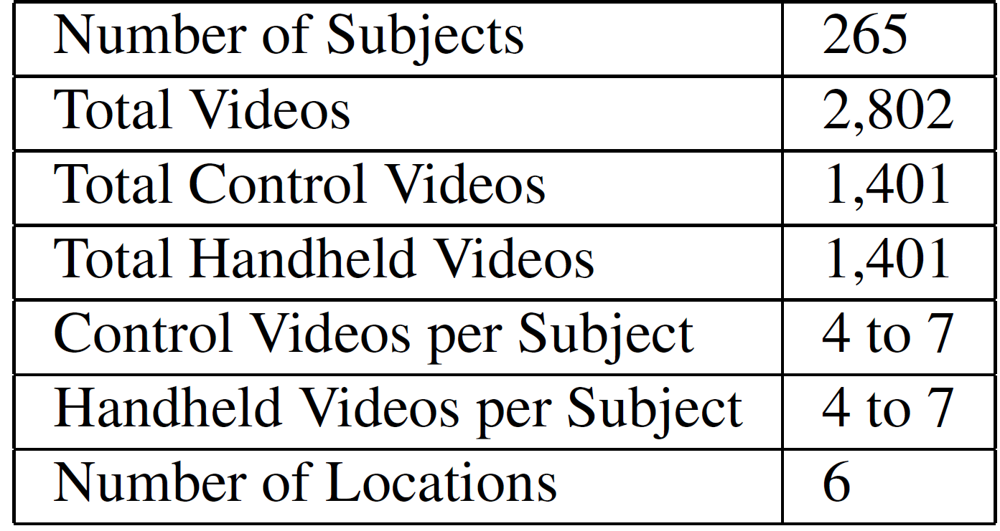
FG 2015 Video FR Challenge
Videos for testing in the PaSC datasets
[Beveridge, BTAS’13]

Slide 19
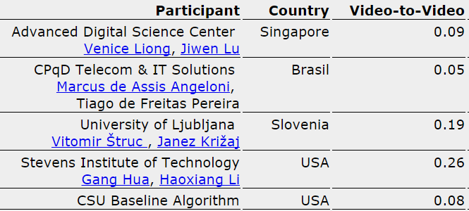
Results in IJCB 2014
Verification rates at FAR=1% for the video-to-video (Exp. 1) and video-to-still (Exp.2) tasks. [Beveridge, IJCB’14]
Handheld experiment
Best method: Eigen Probabilistic Elastic Part (Eigen-PEP) model, CVPR13/ICCV13

Slide 20
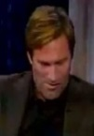
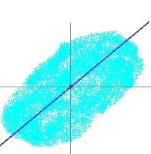

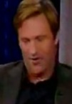
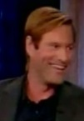

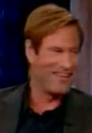
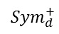
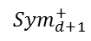
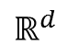
Our Method
DCNN (single frame feature)
HERML(set model and classification)
Softmax Output
Layer 6-2: Full
KLDA
Layer 6-1: Full
$$ℝ^{d}$$
Layer 5-2: Conv
Mean
Layer 5-1: Conv
Layer 4-3: Conv + Pool
KLDA
Fusing on Score level
Layer 4-2: Conv
Layer 4-1: Conv
$${Sym}_{d}^{+}$$
Frame
Layer 3-3: Conv + Pool
Video
Covariance
Layer 3-2: Conv
Layer 3-1: Conv
KLDA
Layer 2-3: Conv + Pool
Layer 2-2: Conv
Gaussian
$${Sym}_{d+1}^{+}$$
Layer 2-1: Conv
Layer 1-3: Conv + Pool
(a) Mul. statistics
(b) Hetero. spaces
(c) KDA Leaning
Layer 1-2: Conv
Layer 1-1: Conv
Input Image
Hybrid Euclidean-and-Riemannian Metric Learning (HERML) [Huang, Wang, Shan, Chen, ACCV’14]
DCNN [Jia’13]

Slide 21
Training Models
Training DCNN
Caffe, Jia’13→14 Cov. Layers (from 5)
Pre-train: CFW
Start learning rate: 0.01
153,461 images from 1520 persons
Fine-tune: PaSC training set + COX
Start learning rate: 0.001
PaSC training set
170 persons, 38113 images
COX training set (our own, surveillance-like videos)
1000 persons, 147,737 video frames
Features exploited finally
2,048 dimensional features of fc 6-2 layer for each frame

Slide 22
Training Models
Training HERML
1,165 videos from 470 person, from two heterogeneous datasets
PaSC training set
170 persons, 265 videos
COX training set
300 persons, 900 videos (3 videos/person)
Final feature dimensions (per video)
1320 (440*3)-dimensional (KLDA features)

Slide 23
Evaluation Results
Softmax Output
Layer 6-2: Full
The deeper the better
Layer 6-1: Full
Layer 5-2: Conv
Layer 5-1: Conv
DCNN for single frame
Softmax Output
Layer 4-3: Conv + Pool
Layer 5-2: Full
Layer 4-2: Conv
Layer 5-1: Full
Layer 4-1: Conv
Softmax Output
Layer 4-3: Conv + Pool
Layer 3-3: Conv + Pool
Layer 4-2: Full
Layer 4-1: Conv
Layer 3-2: Conv
Layer 4-1: Full
Layer 3-1: Conv
Layer 3-3: Conv + Pool
Layer 2-3: Conv + Pool
Layer 3-3: Conv + Pool
Layer 3-1: Conv
Layer 3-2: Conv
Layer 2-2: Conv
Layer 3-1: Conv
Layer 2-3: Conv + Pool
Layer 2-1: Conv
Layer 2-1: Conv
Layer 1-3: Conv + Pool
Layer 2: Conv + Pool
Layer 1-3: Conv + Pool
Layer 1-2: Conv
Layer 1: Conv + Pool
Layer 1-1: Conv
Layer 1-1: Conv
Input Image
Input Image
Input Image
control：41.40%，
handheld：41.62%
control: 47.41% handheld: 48.02%
control: 54.76% handheld: 56.20%
DCNN + HERML (set models)
control：46.61%，
handheld：46.23%
control： 56.20%，
handheld：54.41%
control：58.63%，
handheld：59.14%

Slide 24
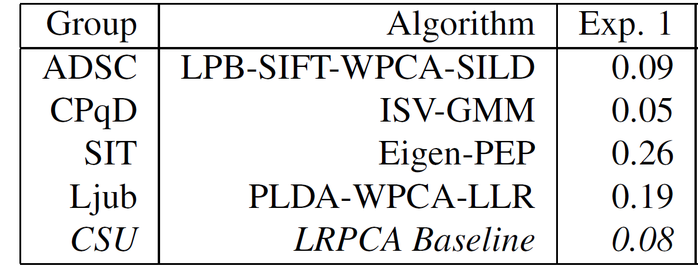
Primary Results
Image features
HOG < Dense SIFT << DCNN
Method | HOG |  | Dense SIFT |  | DCNN
 | Control | Handheld | Control | Handheld | Control | Handheld
HERML | 25.26 | 19.28 | 33.82 | 28.93 | 58.63 | 59.14
*Exp.1 is handheld exp. Table from [Beveridge, IJCB’14]

Slide 25
Outline
Background
CNN (+big data) for feature learning
For EmotioW 2014 challenge
For FG2015 video FR challenge
Deep learning for nonlinear regression
DAE for Face Alignment
DAE for pose normalization
Summary and discussion

Slide 26
Outline
Background
CNN (+big data) for feature learning
For EmotioW 2014 challenge
For FG2015 video FR challenge
Deep learning for nonlinear regression
Coarse-to-Fine Auto-Encoder Networks (CFAN) for Real-Time Face Alignment
DAE for pose normalization
Summary and discussion
J. Zhang, S. Shan, M. Kan, X. Chen. Coarse-to-Fine Auto-Encoder Networks (CFAN) for Real-Time Face Alignment. ECCV2014 (oral)

Slide 27
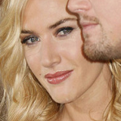
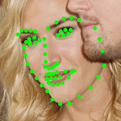
Problem
Face Alignment
Predict facial landmarks from detected face
Goal
Detected face region I(u,v)
Facial landmarks
S=(x₁,y₁, x₂, y₂, …, x_{L}, y_{L})

Slide 28

Problem
Face Alignment
Predict facial landmarks from detected face
Goal
Detected face region I(u,v)
Facial landmarks
S=(x₁,y₁, x₂, y₂, …, x_{L}, y_{L})
$S=H\left(I\right), I∈R^{w∗h}, S∈R^{2L}$,

Slide 29

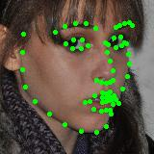

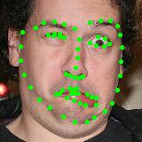

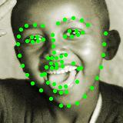
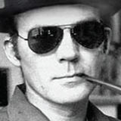
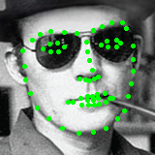
Challenges
H: a complex nonlinear mapping
Large appearance & shape variations
Head pose
Expressions
Illumination
Partial occlusion

Slide 30
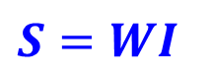
Related Works
ASM & AAM [Cootes’95; Gu’08; Cootes’01; Matthews’04 ]
Sensitive to initial shapes
Sensitive to noise
Hard to cover complex variations
DCNN [Sun’13; Toshev’14]
Shape regression model
Linear Regression [X. Chai, S. Shan, W. Gao. ICASSP’03]
CPR,ESR,RCPR [Dollar’10; Cao’12; Burgos-Artizzu’13]
DRMF [Asthana’13]
SDM [Xiong’13]
$$S=WI$$

Slide 31



Motivation
Directly apply Stacked Auto-Encoder (SAE)? OK, but not good. Why?
Easily overfit to small data
Typically only thousands of images with landmark annotations
Our ideas – exploiting priors
Features are partially handcrafted
SIFT, shape-indexed
Better initialization
Coarse to fine
S
$I$

Slide 32


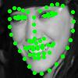
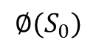
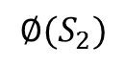


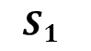
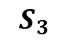

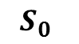

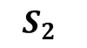

Our Method
Schema of Coarse-to-Fine AE Networks
$$S_{0}$$
$$S_{1}$$
$$S_{2}$$
$$S_{3}$$
${\text{Nonlinear} H}_{0}$
Nonlinear $H_{1}$
Nonlinear $H_{2}$
Nonlinear $H_{3}$
$$I$$
$$∅(S_{0})$$
$$∅(S_{1})$$
$$∅(S_{2})$$
Global SAN
Local SANs
SAN: Stacked Auto-encoder Network

Slide 33
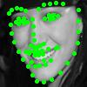


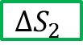
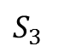
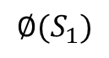

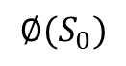
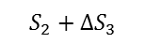
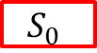
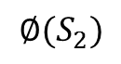

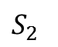

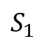
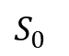
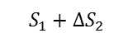
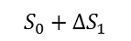
Our Method
Pipeline
$$S_{1}$$
$$S_{2}$$
$$S_{3}$$
$$S_{0}$$
$$S_{0}+{∆S}_{1}$$
$$S_{1}+{∆S}_{2}$$
$$S_{2}+{∆S}_{3}$$
$$S_{0}$$
$${∆S}_{1}$$
$${∆S}_{2}$$
$${∆S}_{3}$$
…
…
…
…
…
…
$$∅(S_{0})$$
$$∅(S_{1})$$
$$∅(S_{2})$$
$$I$$

Slide 34
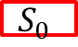
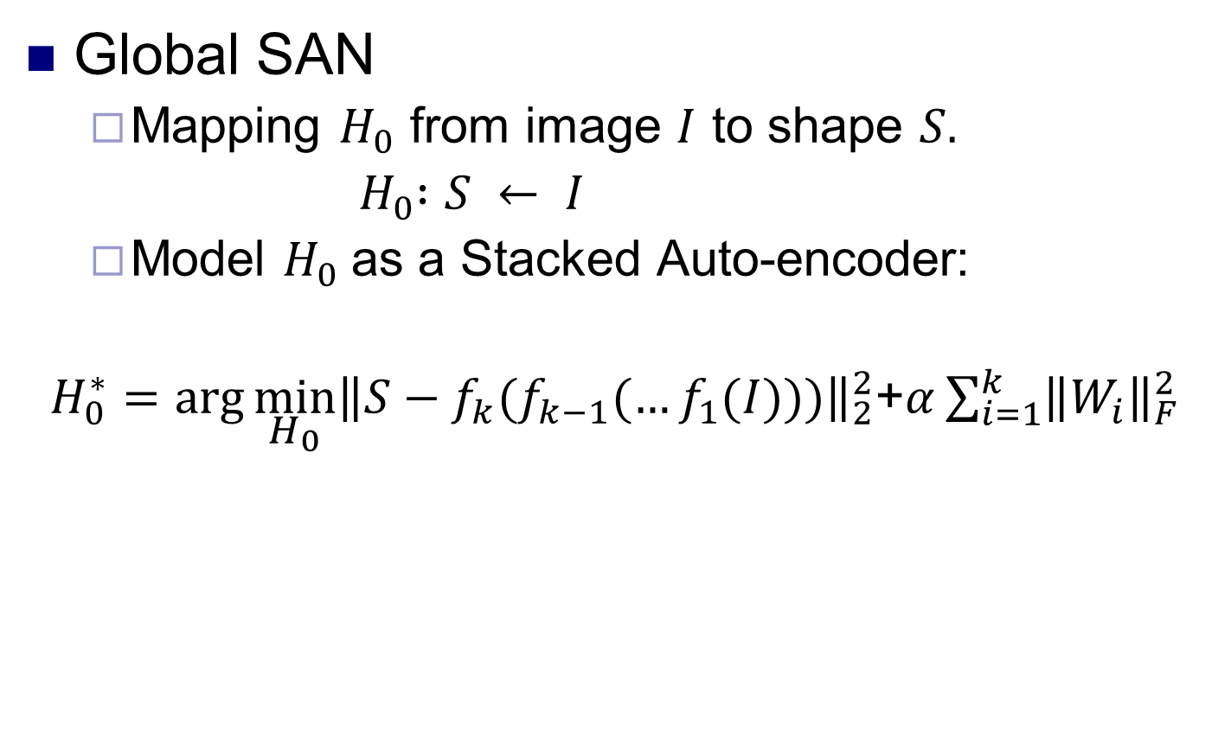
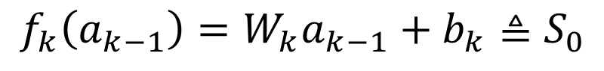
Our Method
$$S_{0}$$
Global SAN
Mapping $H_{0}$ from image $I$ to shape $S.$
${ H}_{0} :S ← I$
Model $H_{0}$as a Stacked Auto-encoder:
$H_{0}^{∗}=\arg{\min_{H_{0}}{{\left\|S−f_{k}(f_{k−1}(…f_{1}(I)))\right\|}_{2}^{2}}}$+$α\sum_{i=1}^{k}{{\left\|W_{i}\right\|}_{F}^{2}}$
$$I$$
Regression
Regularization
$$f_{i}\left(a_{i−1}\right)=σ\left(W_{i}a_{i−1}+b_{i}\right)≜a_{i}, i=1,…,k−1$$
$$f_{k}\left(a_{k−1}\right)=W_{k}a_{k−1}+b_{k}≜S_{0}$$

Slide 35





Our Method
$$S_{1}$$
$$S_{0}+{∆S}_{1}$$
Local SAN
Initialize shape $S_{0}$ from global SAN.
Predict shape deviation with AE
Refine the shape with local features
$∅(S_{0})$: $S_{0}$ shape indexed local features
PCA of concatenated SIFT features
$$H_{1}^{∗}=\arg{\min_{H_{1}}{{\left\|∆S_{1}−h_{k}^{1}\left(…h_{1}^{1}\left(∅\left(S_{0}\right)\right)\right)\right\|}_{2}^{2}}}+α\sum_{i=1}^{k}{{\left\|W_{i}^{1}\right\|}_{F}^{2}}$$
$$∆S_{1}=S−S_{0}$$
$${∆S}_{j}$$
…
…
$$∅(S_{0})$$

Slide 36







Our Method
Coarse-to-fine Cascade
$$H_{j}^{∗}=\arg{\min_{H_{j}}{{\left\|∆S_{j}−h_{k}^{j}\left(…h_{1}^{j}\left(∅\left(S_{j−1}\right)\right)\right)\right\|}_{2}^{2}}}+α\sum_{i=1}^{k}{{\left\|W_{i}^{j}\right\|}_{F}^{2}}$$
$j$: index of local SAN
$k$: index of hidden layer
$$S_{0}$$
$$S_{1}$$
$$S_{2}$$
$$S_{3}$$
Larger search region/step
Smaller search region/step

Slide 37
Experiments(1/8)
Datasets
XM2VTS [Messer’99]
2360 face images collected over 4 sessions under the controlled settings
LFPW [Belhumeur’11]
1132 training images and 300 test images collected from wild condition
HELEN [Le’12]
2330 high-resolution face images collected from the wild, 2000 images for training and 330 images for test
AFW [Zhu’12]
205 images with 468 faces collected from the wild

Slide 38
Experiments(2/8)
Evaluation of Successive SANs
ms
Performance gain of each SAN
(Conduct on LFPW)
Run Time (ms)

Slide 39
Experiments(3/8)
Comparative Methods
Local Models with Regression Fitting
SDM [Xiong’13]
DRMF [Asthana’13]
Tree-structured Models
Zhu et al. [Zhu’12]
Yu et al. [Yu’13]
Deep Model
DCNN [Sun’13]

Slide 40
Experimental Result(4/8)
Performance comparisons on HELEN

Slide 41
Experimental Result(5/8)
Performance comparisons on LFPW

Slide 42
Experimental Result(6/8)
Performance comparisons on XM2VTS

Slide 43

Experimental Result(7/8)
Comparisons with DCNN* [Sun et al., CVPR’13]
XM2VTS LFPW HELEN
Note: The performance is evaluated in terms of five common landmarks

Slide 44





Experimental Result(8/8)
Pose
Expression
Beard
Sunglass
Occlusion

Slide 45
CFAN Summary
Global SAN achieves more accurate initialization
SAE well characterizes the non-linearity from appearance to face shape
Coarse-to-fine strategy is effective
Alleviate the local minimum problem
Impressive improvement and real-time performance

Slide 46
Outline
Background
CNN (+big data) for feature learning
For EmotioW 2014 challenge
For FG2015 video face recognition challenge
Deep learning for nonlinear regression
DAE for Face Alignment
Stacked Progressive Auto-Encoders (SPAE) for face recognition across pose
Summary and discussion
M. Kan, S. Shan, H. Chang, X. Chen. Stacked Progressive Auto-Encoder (SPAE) for Face Recognition Across Poses. CVPR2014

Slide 47


Problem and Existing Solutions
Face Recognition Across Pose
Challenges
Appearance difference caused by pose, even larger than that due to identity
Existing Solutions
Pose-invariant feature representations
Virtual images at target pose
Geometry-based: implicit/explicit 3D recovery
Learning-based: in 2D
×
√

Slide 48




Regression-based Methods
Predict view from one pose to another
Globally linear regression
$$Φ_{P}$$
$$A_{P}$$
$$A_{P}$$
$$Φ_{0}$$
Learning
Predicting
X. Chai, S. Shan, X. Chen and W. Gao. Locally linear regression for pose-invariant face recognition. IEEE T IP (2007).

Slide 49

Regression-based Methods
Predict view from one pose to another
Globally linear regression → Locally linear regression
X. Chai, S. Shan, X. Chen and W. Gao. Locally linear regression for pose-invariant face recognition. IEEE T IP (2007).

Slide 50








Motivation
How about deep model directly?
Stacked de-noising Auto-Encoder
Regard non-fontal view as contaminated version of frontal view
Unfortunately, fail again
Complex non-linear model
Easily overfit to “Small” data
Our idea -- priors
Pose changes smoothly
Progressively reach the final goal
output layer
…
decoder $g_{3}$
…
encoder $f_{3}$
decoder $g_{2}$
…
encoder $f_{2}$
decoder $g_{1}$
…
encoder $f_{1}$
…
input layer

Slide 51








Our Method
Basic idea
Stacking multiple Progressive single-layer Auto-Encoders
Each PAE maps non-frontal faces to another with smaller pose
[ 0º]
output layer
…
decoder $g_{3}$
…
encoder $f_{3}$
[-15º , +15º]
…
decoder $g_{2}$
…
encoder $f_{2}$
[-30º , +30º]
…
decoder $g_{1}$
…
encoder $f_{1}$
[-45º , +45º]
input layer
…

Slide 52

Our Method
Basic idea
Take layer#1 as example
p($x_{output}$) = 30º, if p($x_{input}$) >= 30º
p($x_{output}$) = p($x_{input}$), if p($x_{input}$) < 30º
No need pose estimation for testing
[ 0º]
output layer
…
decoder $g_{3}$
…
encoder $f_{3}$
[-15º , +15º]
…
decoder $g_{2}$
…
encoder $f_{2}$
[-30º , +30º]
…
decoder $g_{1}$
…
encoder $f_{1}$
[-45º , +45º]
input layer
…

Slide 53


Our Method
Discussion
Medium goals restrict the model, thus alleviate overfitting
Multi-view database provides the medium goals
Otherwise, too many feasible solutions
input non-frontal
face image
output virtual frontal view

Slide 54
Our Method
Step1: optimize each single-layer progressive AE
Step2: fine-tune the stacked deep network
Step3: outputs few topmost hidden layers as pose-robust features
Step4: supervised feature extraction via Fisher Linear Discriminant analysis (FLD)
Step5: nearest neighbor classifier is used for recognition

Slide 55

Experimental Results

Slide 56
Experimental Results

Slide 57


Experimental Results
Comparison on Multi-PIE
Comparison on FERET

Slide 58
SPAE Summary
SPAE performs better than other 2D methods, and comparable to 3D ones
SPAE can narrow down pose variations layer by layer, along pose variation manifold
SPAE needs no pose estimation of test image
Prior domain knowledge does help the design of deep network

Slide 59
Outline
Background
CNN (+big data) for feature learning
For EmotioW 2014 challenge
For FG2015 video face recognition challenge
Deep learning for nonlinear regression
DAE for Face Alignment
Stacked Progressive Auto-Encoders (SPAE) for face recognition across pose
Summary and discussion

Slide 60
Summary and discussion
DL (esp. CNN) wins with “big” data
So, collect big data…
The deeper, the better (?)
No ability to collect big data? Or, big data is impossible?
SAE works for nonlinear regression
Past experiences help to build model
Data structure help to design network
Priors help to design the objective functions

Slide 61







Collaborators
Xilin Chen
Ruiping Wang
Mein Kan
Jie Zhang
Mengyi Liu
Zhiwu Huang
Shaoxin Li

Slide 62
Thank you! Q&A

